Slide 1

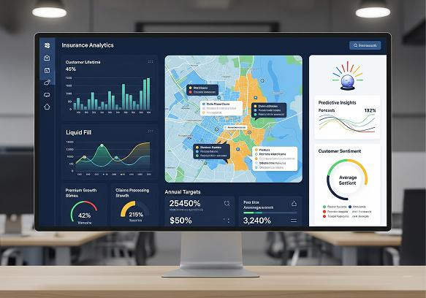
Insurance Analytics Dashboard
Policy Performance & Customer Insight
Tools Used:
✔ Microsoft Excel
✔ MySQL
✔ Power BI
✔ Tableau

Slide 2
Agenda
01. Project Introduction
02. Project Goal
03. Dataset Description
04. Dashboard Overview
05. Key Performance Indicators (KPIs)
06. Excel Dashboard Overview
07. SQL Analysis
08. Power BI Dashboard
09. Tableau Dashboard
10. Conclusion
11. Recommendations

Slide 3

Introduction
The Insurance Analytics Dashboard is developed to analyze insurance policy data and generate meaningful business insights. The dashboard enables users to monitor policy performance, premium collection, customer demographics, payment information, and yearly business trends.
Using interactive visualizations, the dashboard helps management identify patterns, monitor key performance indicators (KPIs), and make data-driven decisions to improve overall business performance.

Slide 4

Project Goal
Objective:
To develop an interactive Insurance Analytics Dashboard that provides meaningful business insights and supports data-driven decision-making.
The dashboard helps to:
Analyze policy performance.
Track premium collection.
Monitor policy status.
Understand customer demographics.
Identify business trends.
Support strategic decision-making.

Slide 5
Dataset Description
The project uses an insurance dataset containing customer, policy, and payment-related information
Policy ID
Customer Age
Gender
Policy Start Date
Policy End Date
Premium Amount
Policy Status
Payment Status
Payment Method
Risk Score
Policy Discount
Settlement Date

Slide 6
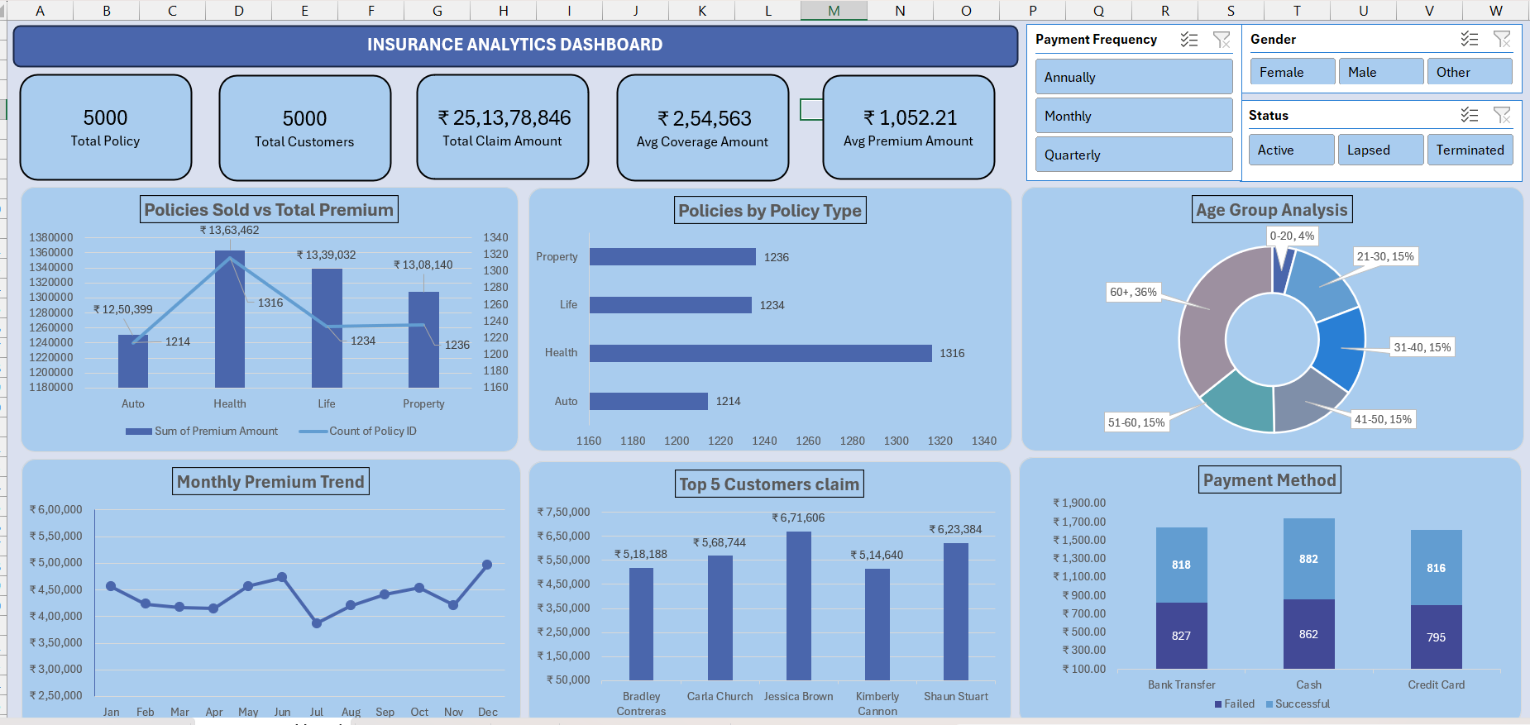
Excel Dashboard Overview

Slide 7
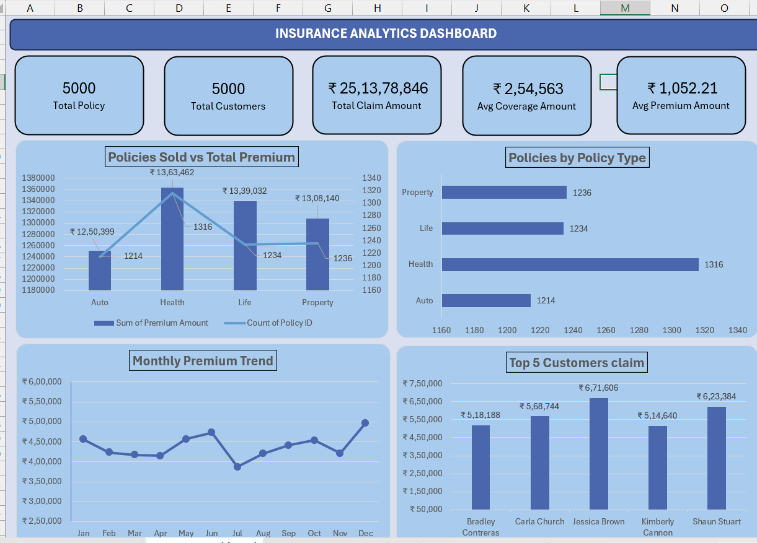
KPI Overview & Policy Performance
KPI Cards summarize overall business performance:
Total Policies: 5,000 and Customers: 5,000.
Total Claim Amount: ₹25.13 Cr.
Avg Coverage: ₹2.54 Lakh | Avg Premium: ₹1,052.
Combo Chart - compares Premium vs Policies Sold.
Bar Chart - shows Health Insurance is the top-selling policy.
Line Chart - tracks monthly premium trend and seasonal changes.

Slide 8
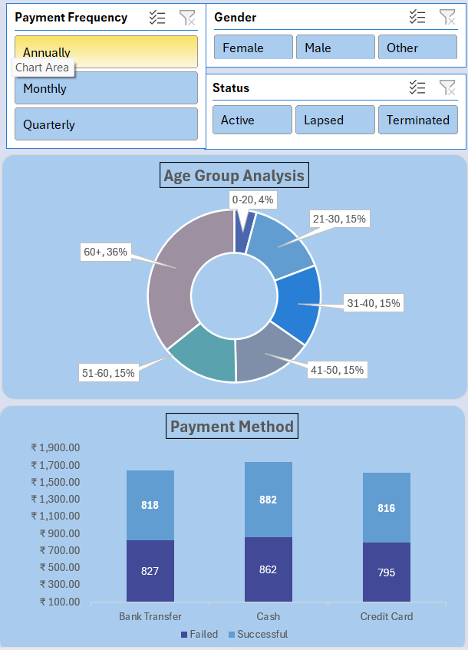
Customer Analysis & Payment Insights
Age Group Analysis shows customers aged 60+ are the largest segment (36%).
The Top 5 Customer Claims chart highlights customers with the highest claim values.
Payment Method chart compares successful and failed transactions.
Slicers (Gender, Status, Payment Frequency) make the dashboard interactive and easy to filter.

Slide 9
Overall Insights, Recommendations & Conclusion
Key Insights:
Health Insurance is the best-performing policy type in both policy count and premium.
Premium collection is consistent throughout the year with a peak in December.
Senior citizens form the largest customer segment, indicating strong demand.
Cash has the highest payment success rate.
Recommendations:
Promote Auto and Life Insurance through targeted marketing.
Encourage digital payments and improve failed transaction handling.
Add KPIs such as Claim Settlement Ratio, Renewal Rate, Agent Performance and Regional Analysis.
Conclusion:
The dashboard provides actionable insights that help management improve profitability, customer retention and operational decision-making.

Slide 10
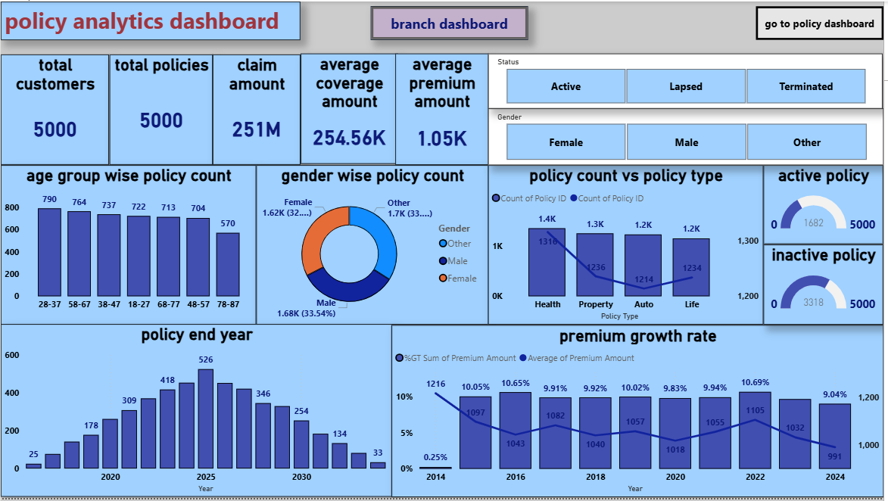
Power Bi Dashboard Overview

Slide 11
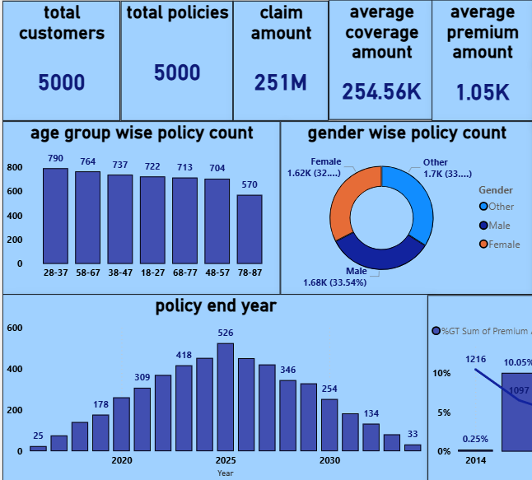
KPI Overview & Policy Performance
KPI Cards summarize overall business performance:
​Total Customers – 5,000
Shows the total number of customers in the insurance dataset.
Total Policies – 5,000
Represents the total number of insurance policies available in the dataset.
Claim Amount – 251M
Displays the total claim amount associated with the insurance policies.
Average Coverage Amount – 254.56K
Shows the average insurance coverage amount provided to customers.
Average Premium Amount – 1.05K
Represents the average premium amount paid by customers for their insurance policies.

Slide 12
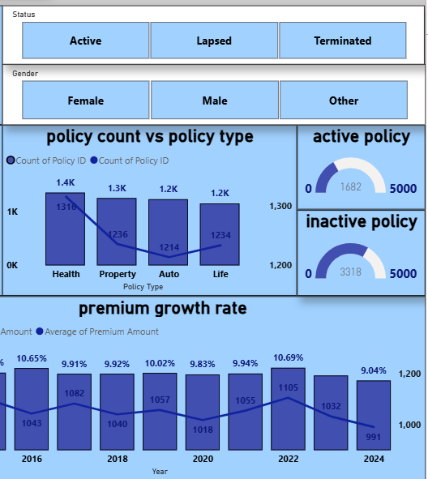
Policy Status & Gender Filters
This section of the Insurance Policy Dashboard provides interactive filters and visualizations to analyze policy status, gender, policy type, active/inactive policies, and premium growth.
Status Filter
Active
Lapsed
Terminated
2. Gender Filter
Female
Male
other
Overall, the Status and Gender filters make the dashboard interactive and user-friendly. They help users perform focused analysis by selecting a specific policy status or customer gender.

Slide 13
Overall Insights, Recommendations & Conclusion
Key Insights:
The dashboard provides a clear overview
of customer demographics, policy performance,
claims, and premium trends. It highlights the
active and inactive policies, popular policy types,
and yearly premium growth, helping management
make better business decisions.
Recommendations:​
​
Promote Auto and Life Insurance through targeted marketing.​
Encourage digital payments and improve failed transaction handling.​
Add KPIs such as Claim Settlement Ratio, Renewal Rate, Agent Performance and Regional Analysis.​
Conclusion: ​
​
The dashboard provide actionable insights that help management improve profitability, customer retention and operational decision-making.​

Slide 14
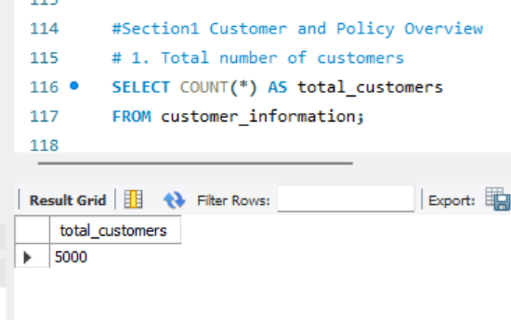
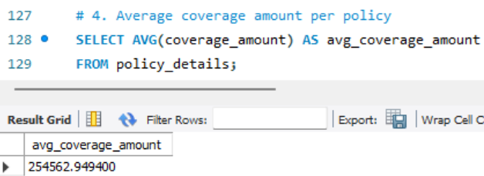
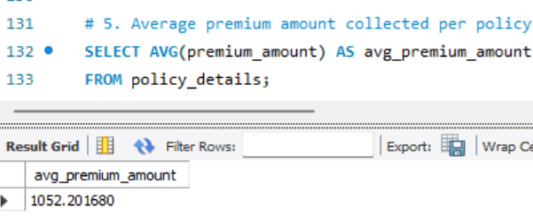
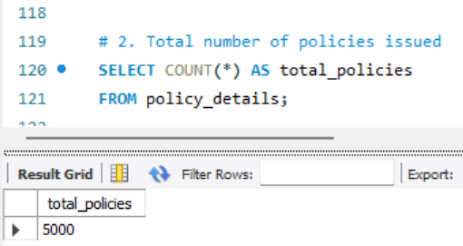
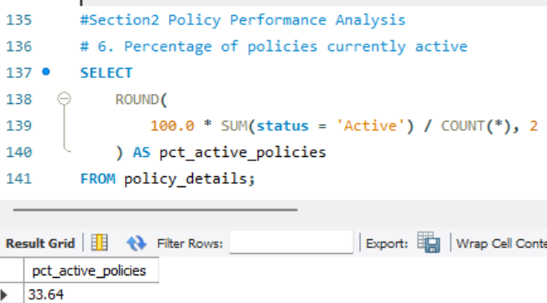
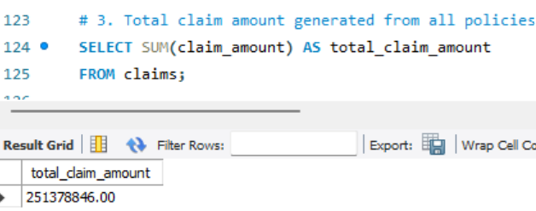
SQL Queries

Slide 15
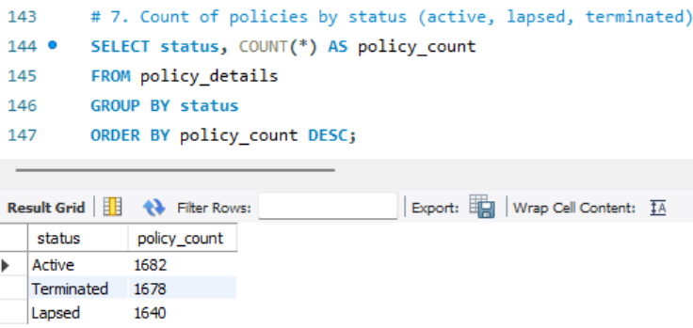
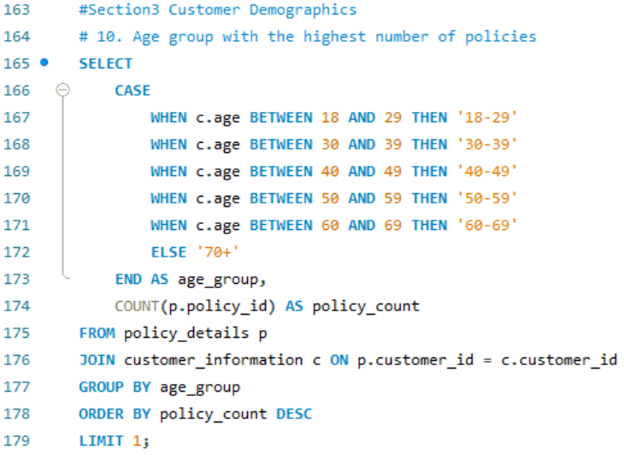
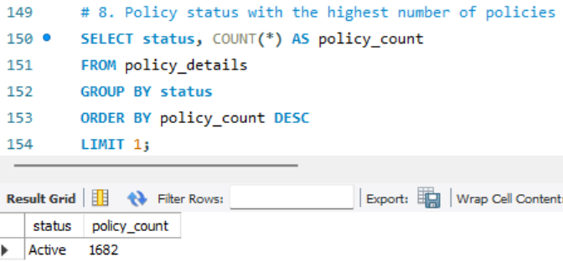
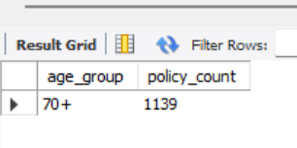
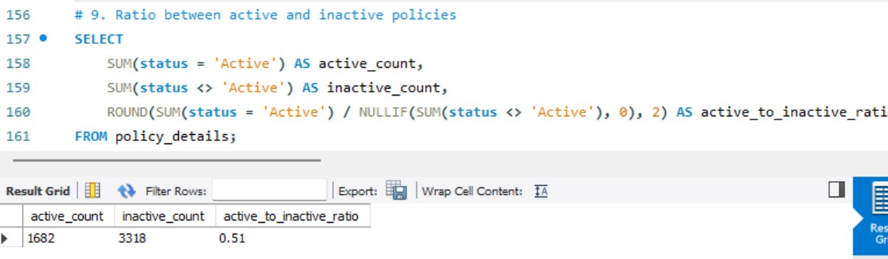

Slide 16
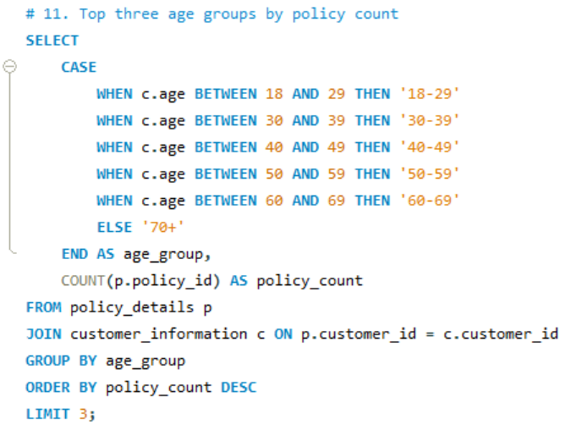
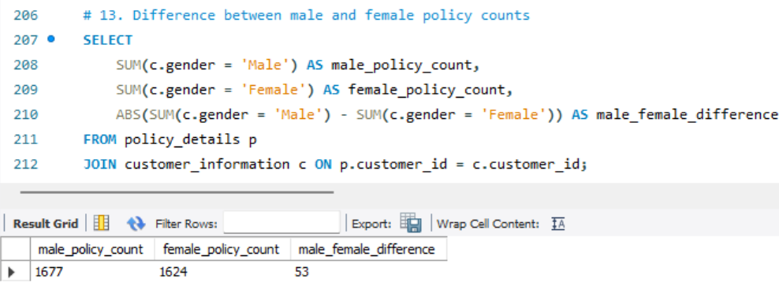
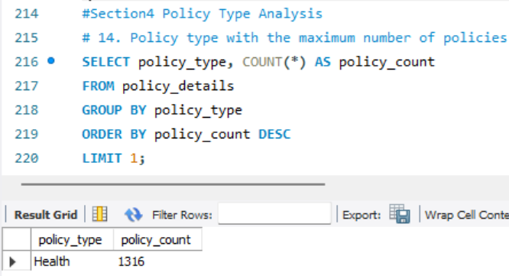
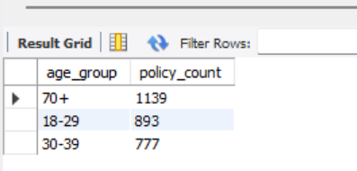
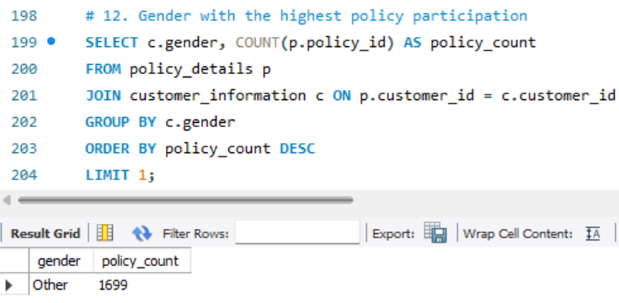
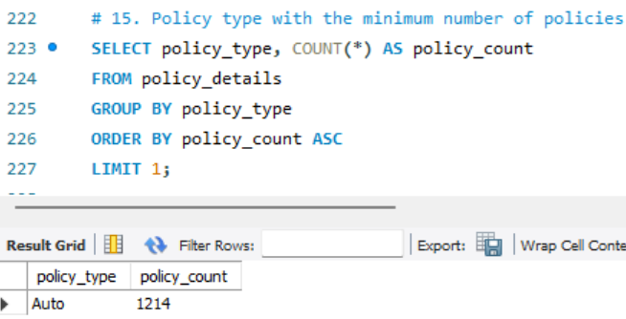

Slide 17
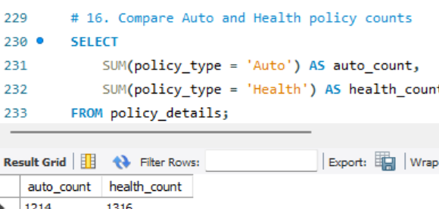
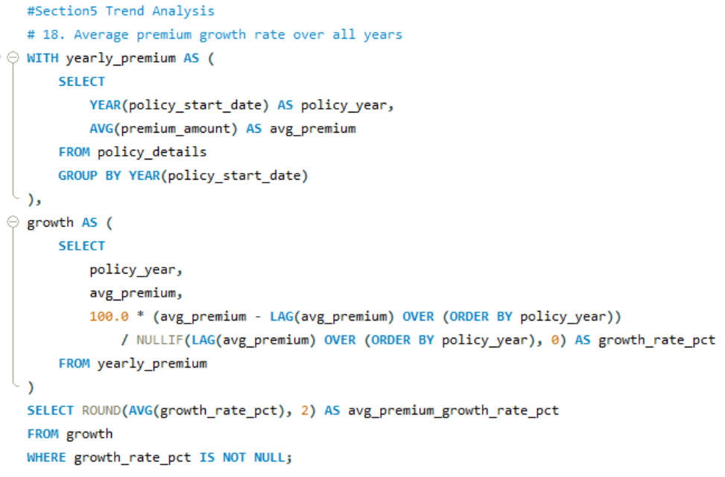
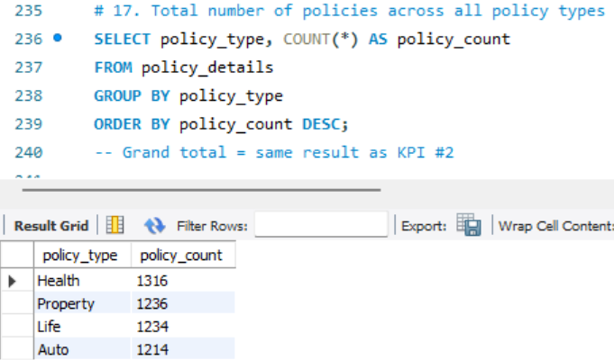
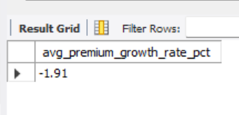
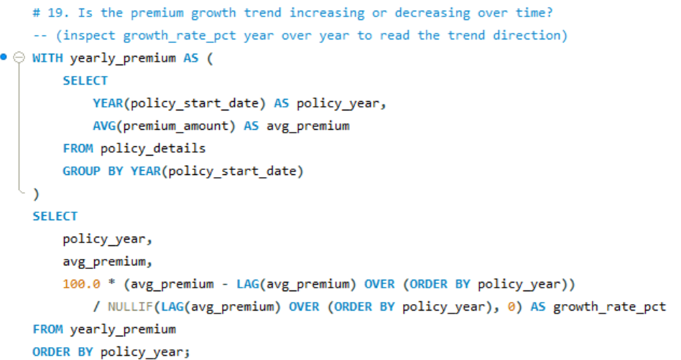
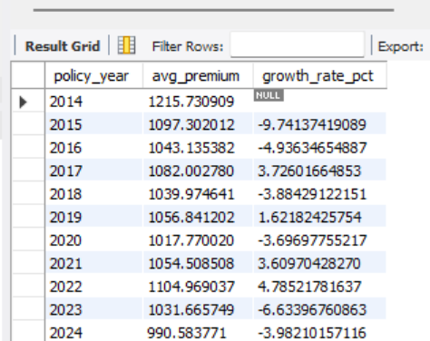

Slide 18
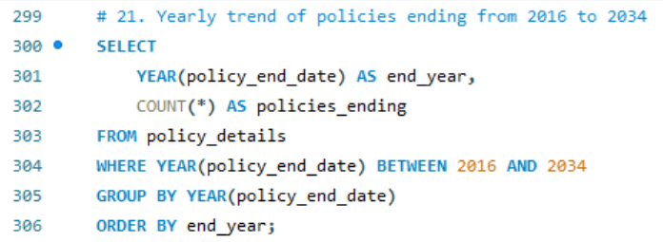
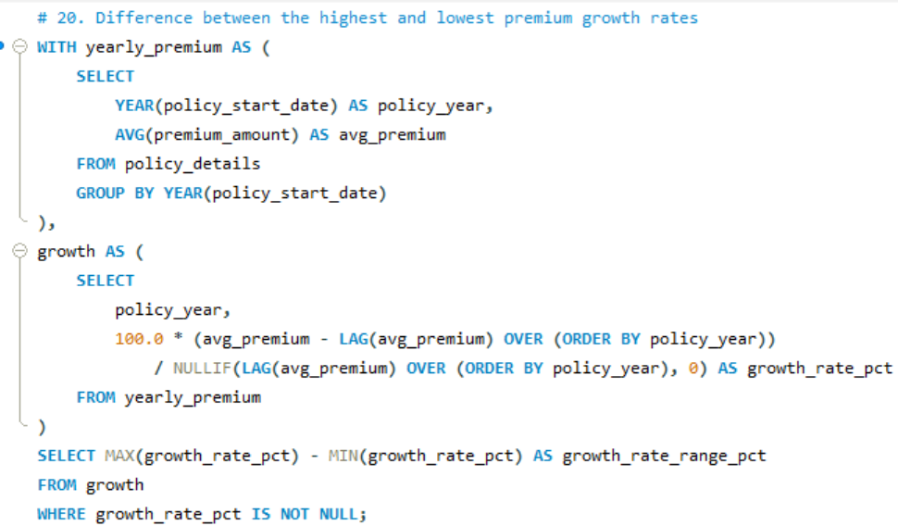
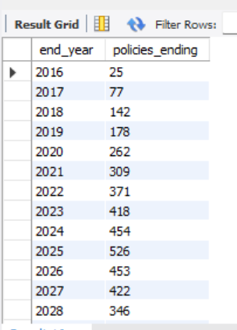
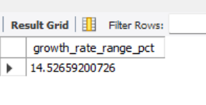
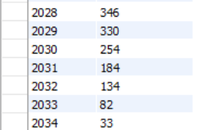

Slide 19
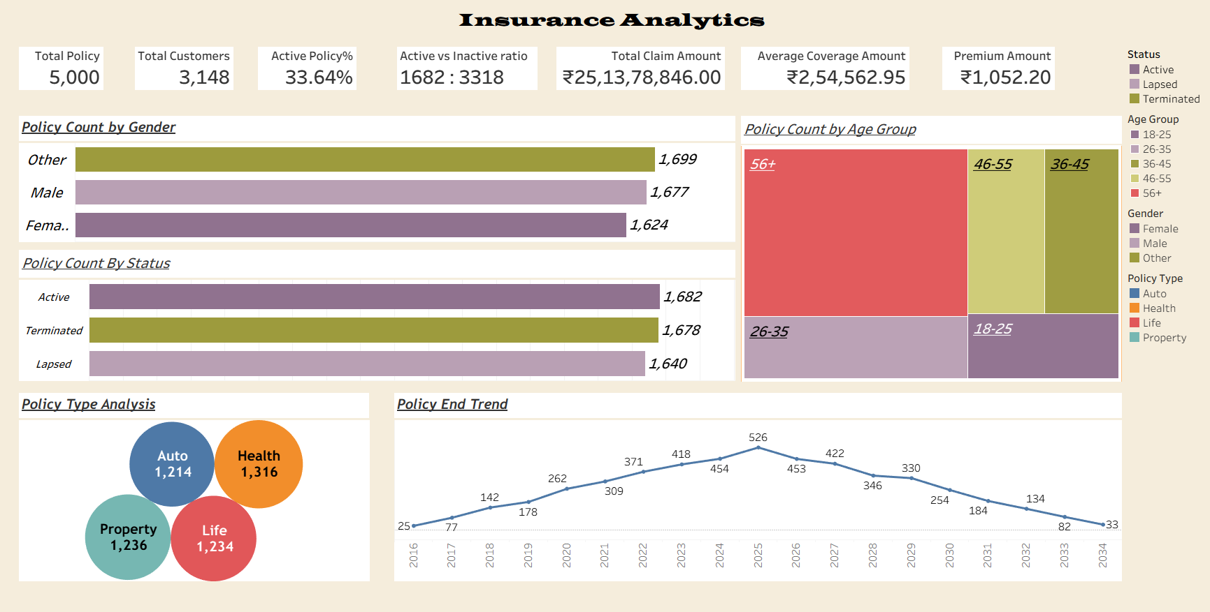
Tableau Dashboard overviews

Slide 20
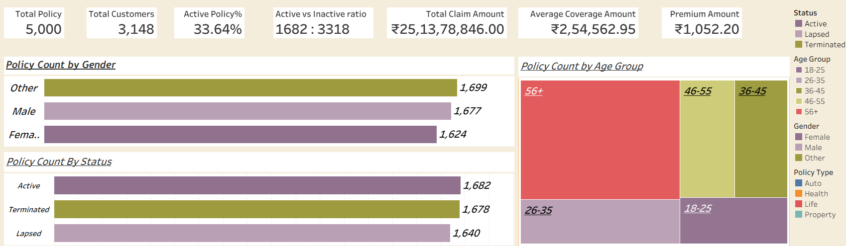
KPI Overview & Policy Performance
KPI Cards summarize overall business performance:
Total Policies: 5,000 | Total Customers: 3,148
Active Policies: 33.64%
Policy Coverage Range: 1,682 – 3,318
Total Claim Amount: ₹25.13 Cr
Average Coverage: ₹2.54 Lakh | Average Premium: ₹1,052
Policy Count by Gender – compares the number of policies purchased by Male, Female, and Other customers.
Policy Count by Status – shows the distribution of Active, Approved, and Lapsed policies.
Policy Count by Claim Status (Tree map) – highlights the number of policies by claim status such as Rejected, Pending, Approved, and Paid, making it easy to identify the largest category.

Slide 21
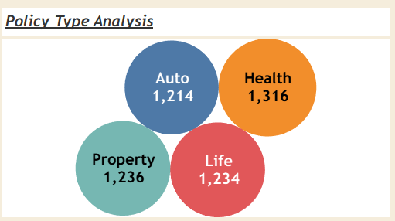
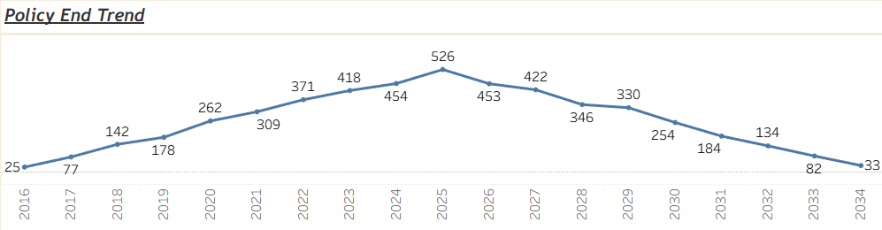
Policy Type Analysis & Policy Trend Analysis
Policy Type Analysis summarizes the distribution of policies across different insurance categories:
Health Insurance has the highest number of policies (1,316).
Property Insurance: 1,236 policies.
Life Insurance: 1,234 policies.
Auto Insurance: 1,214 policies.
The distribution is balanced, with Health Insurance being the most popular policy type.
Policy End Trend tracks the number of policy expirations over time.
The trend increases gradually and reaches its peak in the middle of the period.
After the peak, policy expirations decline steadily.
This chart helps identify seasonal patterns and supports timely policy renewal planning

Slide 22
Overall Insights, Recommendations & Conclusion
Key Insights:
The dashboard provides a comprehensive overview of policy performance, customer demographics, premium trends, and claim analysis.
Health Insurance is the most popular policy type, while policy distribution remains balanced across all categories.
KPI metrics help track total policies, claims, average premium, and coverage for better business monitoring.
Policy trend analysis highlights seasonal patterns and supports renewal planning
Recommendations:
Increase marketing efforts for Auto and Life Insurance to improve policy sales.
Focus on customer retention by encouraging timely policy renewals.
Monitor claim status regularly to improve claim settlement efficiency.
Add advanced KPIs such as Renewal Rate, Claim Settlement Ratio, Customer Retention Rate, and Regional Performance.
Conclusion:
The Insurance Analytics Dashboard delivers meaningful insights into policy performance, customer behavior, claims, and premium trends. It supports data-driven decision-making, improves operational efficiency, and helps identify opportunities for business growth.
This is professional, concise, and suitable for presenting your Power BI insurance dashboard during interviews or project demonstrations.

Slide 23
Conclusion
Too many policies are inactive.
Only 1 in 3 policies (33.64%) is active — most of the book has lapsed or been terminated.
A big renewal wave is coming.
526 policies end in 2025, the largest expiry group we have — a real risk of losing more customers.
Premium income is unstable.
Growth swings up and down every year instead of rising steadily.
Health insurance is the strongest product.
It sells the most and brings in the most premium — our biggest strength.

Slide 24
Recommendations
Simple next steps to fix the gaps
1
Call and remind customers before their policy expires, starting with the 2025 group.
Win back lapsed customers with simple offers, especially older (56+) customers.
Promote Auto insurance more, since it sells the least right now.
Fix online payment problems so fewer transactions fail.
2
3
4

Slide 25
THANK YOU

